Slide 1
Sustainable tourism
In the national parks of Finland
(Aimo Saano 3 May 2018)

Slide 2
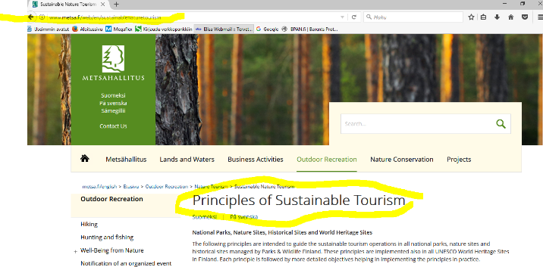
Sustainable tourism in the national parks of Finland

Slide 3
Sustainable tourism in the national parks of Finland
National Parks, Nature Sites, Historical Sites and World Heritage Sites
The following principles are intended to guide the sustainable tourism operations in all national parks, nature sites and historical sites managed by Parks & Wildlife Finland. These principles are implemented also in all UNESCO World Heritage Sites in Finland. Each principle is followed by more detailed objectives helping in implementing the principles in practice.
Principles of Sustainable Tourism: National Parks, Nature Sites, Historical Sites and World Heritage Sites 2016 (julkaisut.metsa.fi)
Sustainable Tourism in Protected Areas. Guide for tourist companies (julkaisut.metsa.fi)

Slide 4
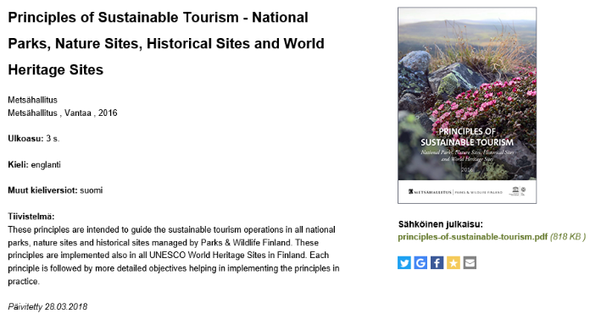
Sustainable tourism in the national parks of Finland

Slide 5
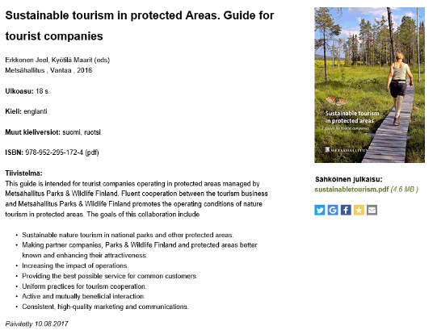
Sustainable tourism in the national parks of Finland

Slide 6
Sustainable tourism in the national parks of Finland
We promote sustainable tourism. In order to achieve this goal, we cooperate to...
1. Support the preservation of valuable features at the sites and promote their protection
Natural and cultural values are important factors in terms of attracting tourists.
We inform visitors of the values of the site and their protection and encourage visitors to act responsibly.
We develop services and direct the use of the sites, taking into account demand and the site characteristics.
We mainly use existing routes and service structures.
In construction, we also take account of local natural and cultural values.
We ensure that tourism does not compromise natural or cultural values and we prevent any harmful impacts proactively.

Slide 7
Sustainable tourism in the national parks of Finland
2. Minimise the load on the environment
We promote opportunities to travel to the destination on public transport with low emissions.
We increase the duration of visitors’ stay in the area.
We operate with energy and material efficiency.
We set a good example in environmental issues.
We enable and encourage visitors to act in an environmentally friendly manner.

Slide 8
Sustainable tourism in the national parks of Finland
3. Strengthen local aspects
Local knowledge, research information, experience and culture provide a starting point for delivering experiences.
The guidance provided is of high quality, and operators know the area and local conditions well.
We increase the appreciation of the site by means of high-quality tourist services.
We cooperate and offer local residents and visitors the opportunity to take part in the management and development of the site.

Slide 9
Sustainable tourism in the national parks of Finland
4. Promote use of the sites to increase health and well-being
We encourage visitors to engage in versatile natural and cultural experiences on their own and in guided groups.
We ensure the safety of all sites and services.
Our services promote equality.
We enhance visitors’ opportunities to increase their social, psychological and physical well-being.
We promote local residents’ recreation and improve living conditions in the area.

Slide 10
Sustainable tourism in the national parks of Finland
5. Promote growth and job creation in the local economy
We offer visitors high-quality services based on the attraction of the site.
We cooperate actively with other operators in the management of sites and the provision of services, with clearly defined roles and responsibilities.
We provide easily accessible and interesting information on the sites and services in advance using various channels.
We encourage visitors to stay longer in the area.

Slide 11
Sustainable tourism in the national parks of Finland
6. Communicate together the values and services of the site
We are committed to the values and basic messages of the site.
We communicate consistently and responsibly with different target groups both in Finland and abroad.
We collect feedback from stakeholders in order to improve customer satisfaction and our activities.
We organise training and cooperation events for operators in the area.
We encourage operators to commit themselves to these principles of sustainable tourism.

Slide 12
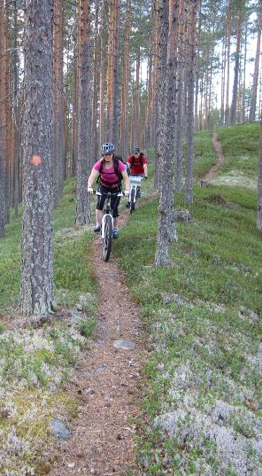
Suojelualueiden hoidon ja käytön periaatteet ohjenuorana
Polkujuoksu ja maastopyöräily sallittua jokamiehenoikeudella
MTB sallittu selvästi erottuvilla poluilla
Rajoitukset LS-syistä (kaikki jokamiesliikkuminen)
Rajoitukset turvallisuussyistä ”ruuhkakohdat”, mtb-etiketti
Uudet linjat käytössä koko maassa HKS- ja järjestyssääntöjen päivitysten kautta (noin 10v ”kierros”)

Slide 13
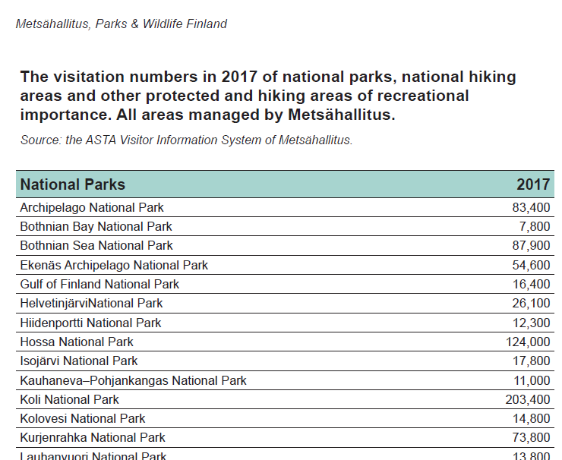
Sustainable tourism in the national parks of Finland
Metsähallitus Parks & Wildlife Finland collect visitation numbers of the most popular state-owned protected and hiking areas in its administration. The data is collected by many different methods. Visitor counters, for example, are used to collect information on users of trails and hiking facilities..

Slide 14
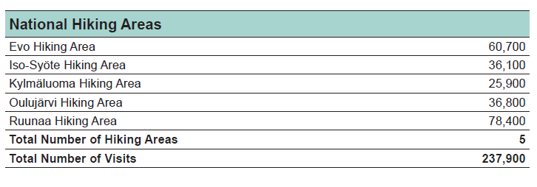
Sustainable tourism in the national parks of Finland

Slide 15
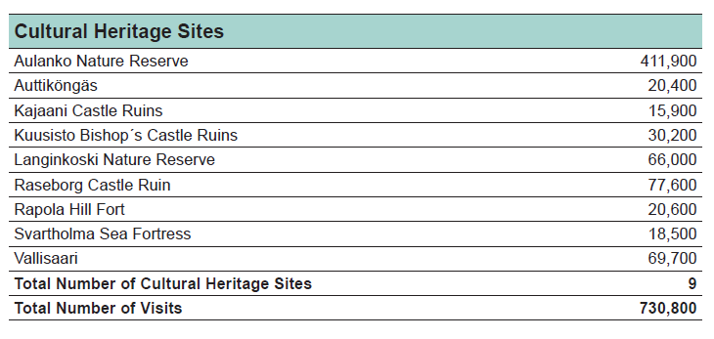
Sustainable tourism in the national parks of Finland

Slide 16
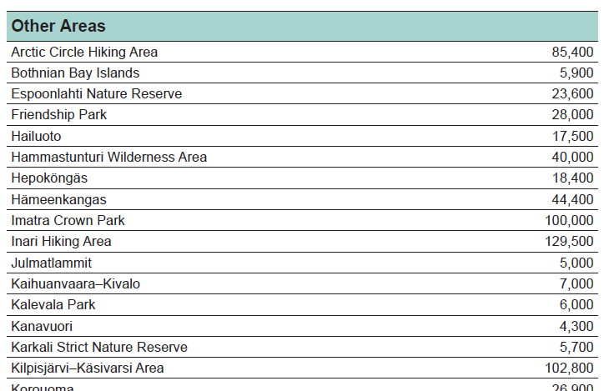
Sustainable tourism in the national parks of Finland

Slide 17
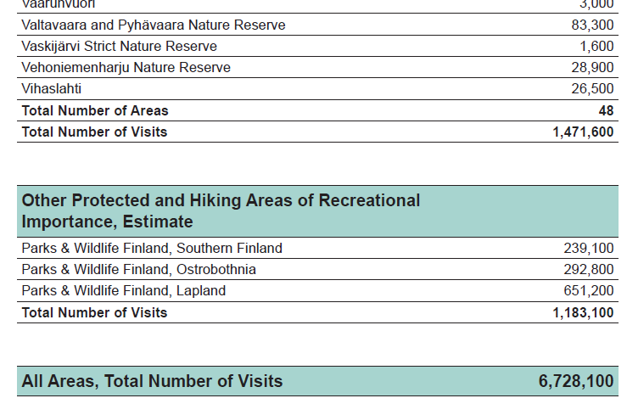
Sustainable tourism in the national parks of Finland

Slide 18
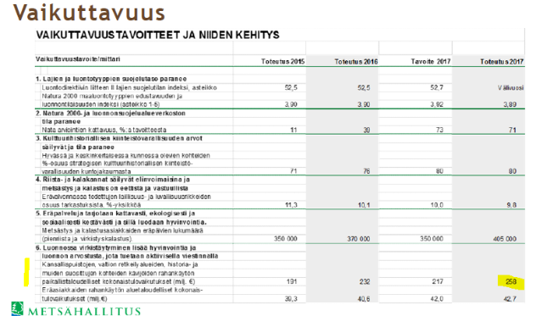
Sustainable tourism in the national parks of Finland

Slide 19
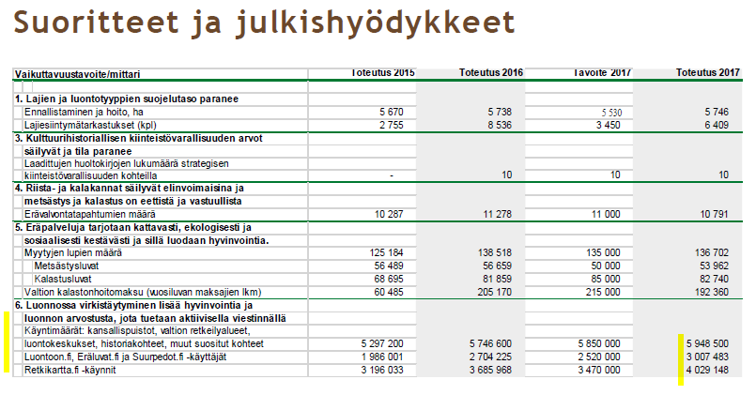
Sustainable tourism in the national parks of Finland

Slide 20
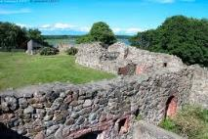
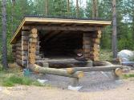
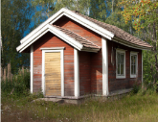
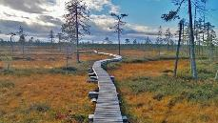
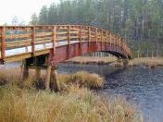
PAVE = Service facilities information system
Data recorded / stored in the system
Constructions: buildings, constructions, bridges and archaeological sites
Construction groups: hierarchical group containing structures
Route network: routes, route parts
Operations: for constructions and route parts
Operational plans: collection of operations, impact assessment, risk analysis, participation
Permits: necessary permits for operations
Monitoring: amount of energy and water consumption and waste accumulation
Cultural heritage: conservation, architectural heritage and other cultural values
Notes:
Rakennustyyppinen reaalimaailman kohde. Maankäyttö- ja rakennuslain 113 pykälän mukaan[2] rakennus on asumiseen, työntekoon, varastointiin tai muuhun käyttöön tarkoitettu kiinteä tai paikallaan pidettäväksi tarkoitettu rakennelma, rakenne tai laitos, joka ominaisuuksiensa vuoksi edellyttää viranomaisvalvontaa turvallisuuteen, terveellisyyteen, maisemaan, viihtyisyyteen, ympäristönäkökohtiin taikka muihin tämän lain tavoitteisiin liittyvistä syistä.
Rakennuksena ei kuitenkaan pidetä kooltaan vähäistä ja kevytrakenteista rakennelmaa tai pienehköä laitosta, ellei sillä ole erityisiä maankäytöllisiä tai ympäristöllisiä vaikutuksia.
Oikeudellisessa määrittelyssä rakennuksen käsitteeseen liittyy oleellisesti viranomaisvalvonnan tarve. Ympäristövaikutustensa vuoksi rakennelmaakin voidaan pitää rakennuksena ja rakennuksen tekemiseen tarvitaan aina rakennuslupa. Muutoin rakennelmien ja pienehköjen laitosten pystyttämiseen tai sijoittamiseen riittää toimenpidelupa.
Rakennusta vähäisemmät rakentamisen tuotteet ovat rakennelmia. Rakennuksen ja rakennelman välinen raja ei ole yksiselitteinen vaan on aina tapauskohtaisesti harkittava mihin kohdeluokkaan kohde kuuluu. Kohdeluokat ovat dynaamisia siten, että luokkien jäsenet voivat vaihtaa luokkaansa

Slide 21
Using the PAVE system in practice
Main activities
Maintenance
Renovation
Construction and demolition
Maintenance of data quality
Supervision and monitoring
Reporting and browsing
Management of cultural heritage sites
Operational planning
Using data for annual work planning

Slide 22
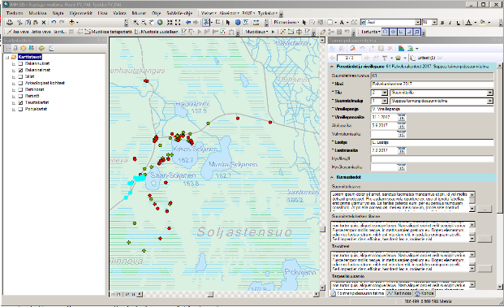
Constructing visitor facilities and other constructions
Stored operational needs from the system
Planning initiated and operational plan established into the system
Operational measures connected to plan and impacts assessed
Proposal circulated and finalised operational plan approved
Planned measures implemented and registered into the system
Operational plan registered into the system as implemented

Slide 23

ASTA – Customer information system
CONTINUOUS FEEDBACK
  Visitor centres and other customer service points
VISITOR SURVEYS
  In protected areas periodically
  Annually in visitor centres and other customer service points
  Historical sites
  Nature tourism enterprises
VISITING AMOUNTS
  In protected areas
  Customer service points

Slide 24
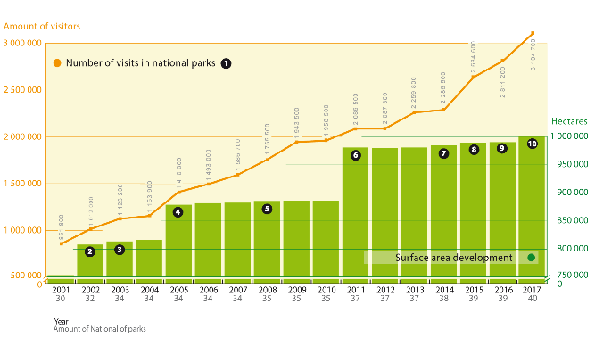
Visitor numbers to National Parks in constant growth
Notes:
1. Taulukon käyntimäärämuutos (%) on laskennallinen ja lukua ovat kasvattaneet käyntimäärien kasvun lisäksi hallinnolliset päätökset, erityisesti kansallispuistojen laajentaminen tai uusien perustaminen.
2. 2002 silloiset Pallas-Ounastunturin ja Pyhätunturin kansallispuistot siirtyivät Metsähallituksen hallintaan.
3. 2003 perustettiin Leivonmäen ja Repoveden kansallispuistot.
4. 2005 Pallas-Ounastunturin kansallispuisto liitettiin osaksi huomattavasti laajempaa Pallas-Yllästunturin kansallispuistoa ja
Pyhätunturin kansallispuisto vastaavasti osaksi laajempaa Pyhä-Luoston kansallispuistoa.
5. 2008 Kolin kansallispuisto siirtyi Metsähallituksen hallintaan.
6. 2011 perustettiin Selkämeren ja Sipoonkorven kansallispuistot.
7. 2014 perustettiin Etelä-Konneveden kansallispuisto.
8. 2015 perustettiin Teijon kansallispuisto ja
Örö liitettiin osaksi Saaristomeren kansallispuistoa.
9. 2016 Rauman kaupungin alueet liitettiin osaksi Selkämeren kansallispuistoa.
10. 2017 perustettiin Hossan kansallispuisto.

Slide 25
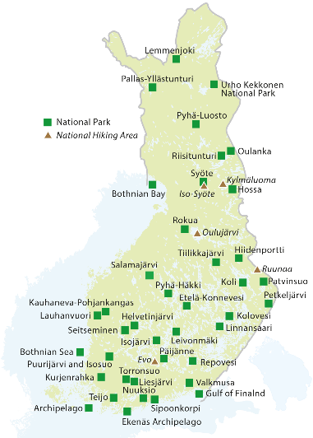
National Parks and
National Hiking Areas
40 national parks, total area 10,018 km²
5 national hiking areas, total area
243 km²
Parks & Wildlife Finland provides basic facilities: 6,000 km of trails, 2,000 km of skiing routes and ca. 2,000 campfire sites, and wilderness huts.

Slide 26
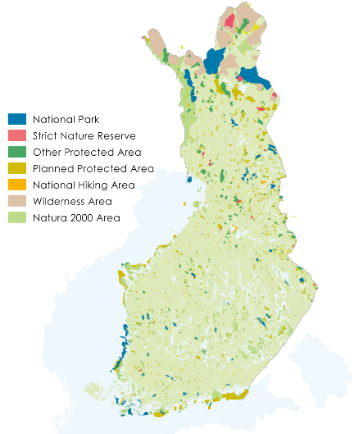
Parks & Wildlife Finland manages our most pristine nature and cultural heritage
One organization to manage all state-owned areas reserved for nature conservation and hiking:
  40 national parks
  19 strict nature reserves
  5 national hiking areas
  12 wilderness areas in Lapland
  over 3,000 other protected areas
  and cultural heritage sites
  Staff all over the country: 505 person years in 2017.

Slide 27
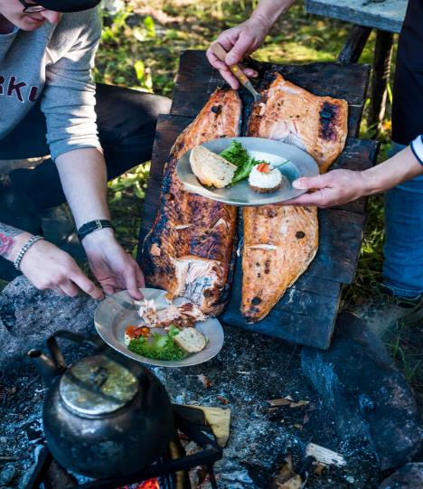
Visits to nature improve our well-being
In Finland, everyman´s rights let us all enjoy the unique nature and its richness.
5.5 million inhabitants in Finland - Altogether 5.9 million visits to national parks, hiking areas, nature centres & other popular nature destinations.
Over 3.1 million visits to national parks and 238,000 to hiking areas in 2017.
87 % of the visitors to national parks and hiking areas estimate that the visit had health benefits.
The health benefit was estimated on average worth 100 € per visit.

Slide 28
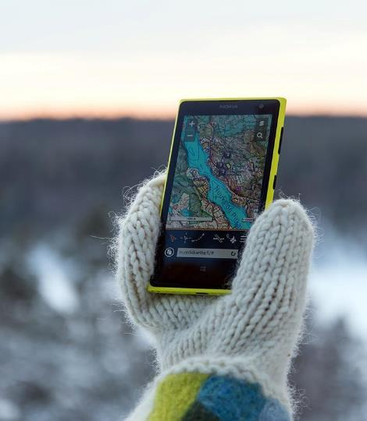
We serve customers in nature and online
27 nature centres maintained by us or
by entrepreneurs
Co-operation with nature tourism entrepreneurs: 600 contracts
Nationalparks.fi: over 2 million unique visitors in 2017.
Online maps from Excursionmap.fi:
4 million visits in 2017
www.zhongwen.nationalparks.fi/zh
https://www.haltia.com/zh/

Slide 29
Nature creates wealth and employment
In 2017, visits to National Parks
generated 206M € per year to local
economies and National Hiking
Ares 10,9M€.
For each euro invested by the State to the basic services of National Parks, the visitors’ spending generates
10 € to local economies.
In 2017, effect of visits to the
40 National Parks on local employment = 2055 person years.
To the 5 National Hiking Areas = 116 person years.
More than 50 % of international travellers coming to Finland come here because of nature.

Slide 30
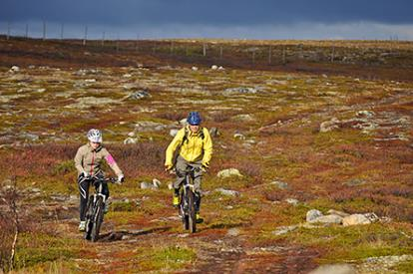
Metsähallituksen kokemuksia uusista polkulajeista viime vuosilta
Maastopyöräily lisääntynyt paikoin merkittävästi, kun se on sallittu HKS:ssa (etenkin Pallas-Ylläs, Syöte)
Polkujuoksutapahtumat vetonauloina
Liiketoimintaa ja luontomatkailua, palvelut kasvussa
Polkujen yhteiskäyttö on sujuvaa, kulutusvaikutus jalkaisin liikkumiseen verrattavaa (jälki erilainen)
Asenteet osittain ”jähmeitä” - vielä uutta, ei totuttu kohtaamaan ”erämaassa” tai pitkoksilla
Kotimaista tutkimustietoa ekologisista ja sosiaalisista vaikutuksista kaivataan

Slide 31
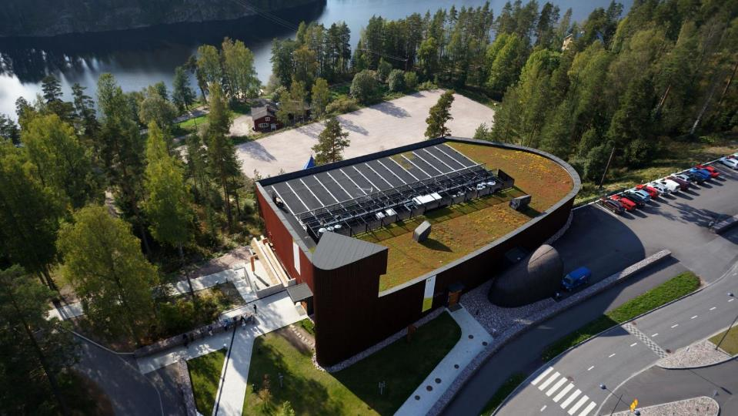
Haltia – the Finnish Nature Centre
Спасибо!

